Slide 1
Mr B asks:
“Where in the world?”

Slide 2
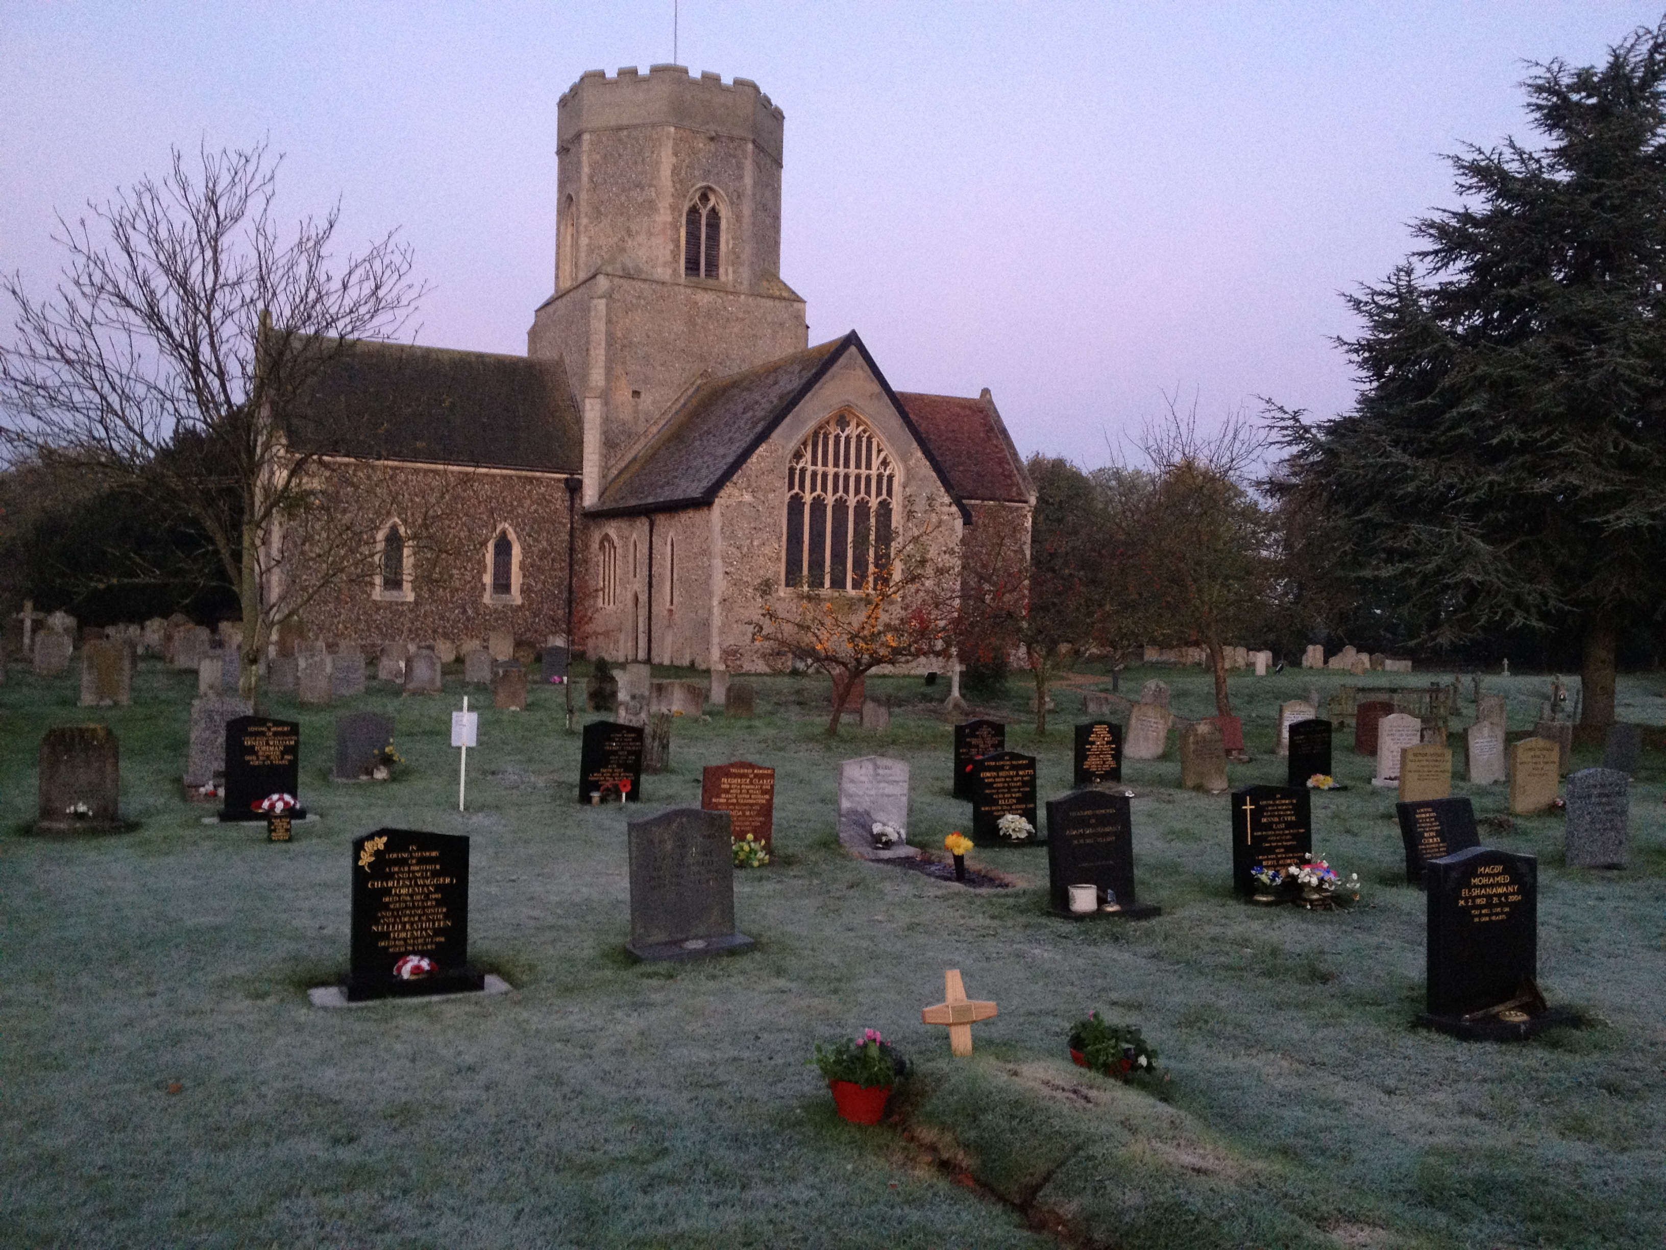

Slide 3
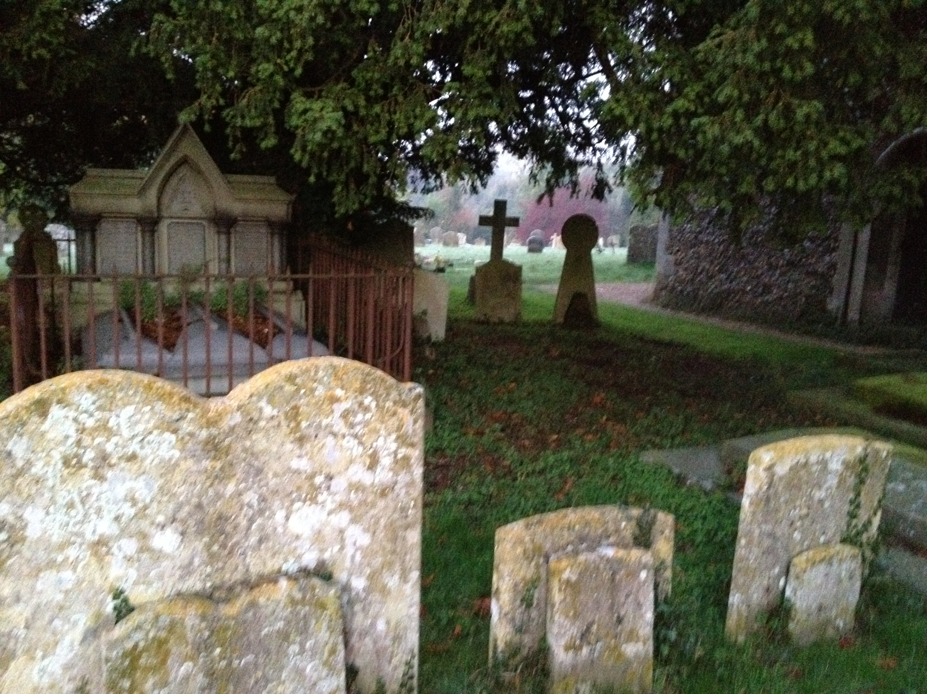

Slide 4
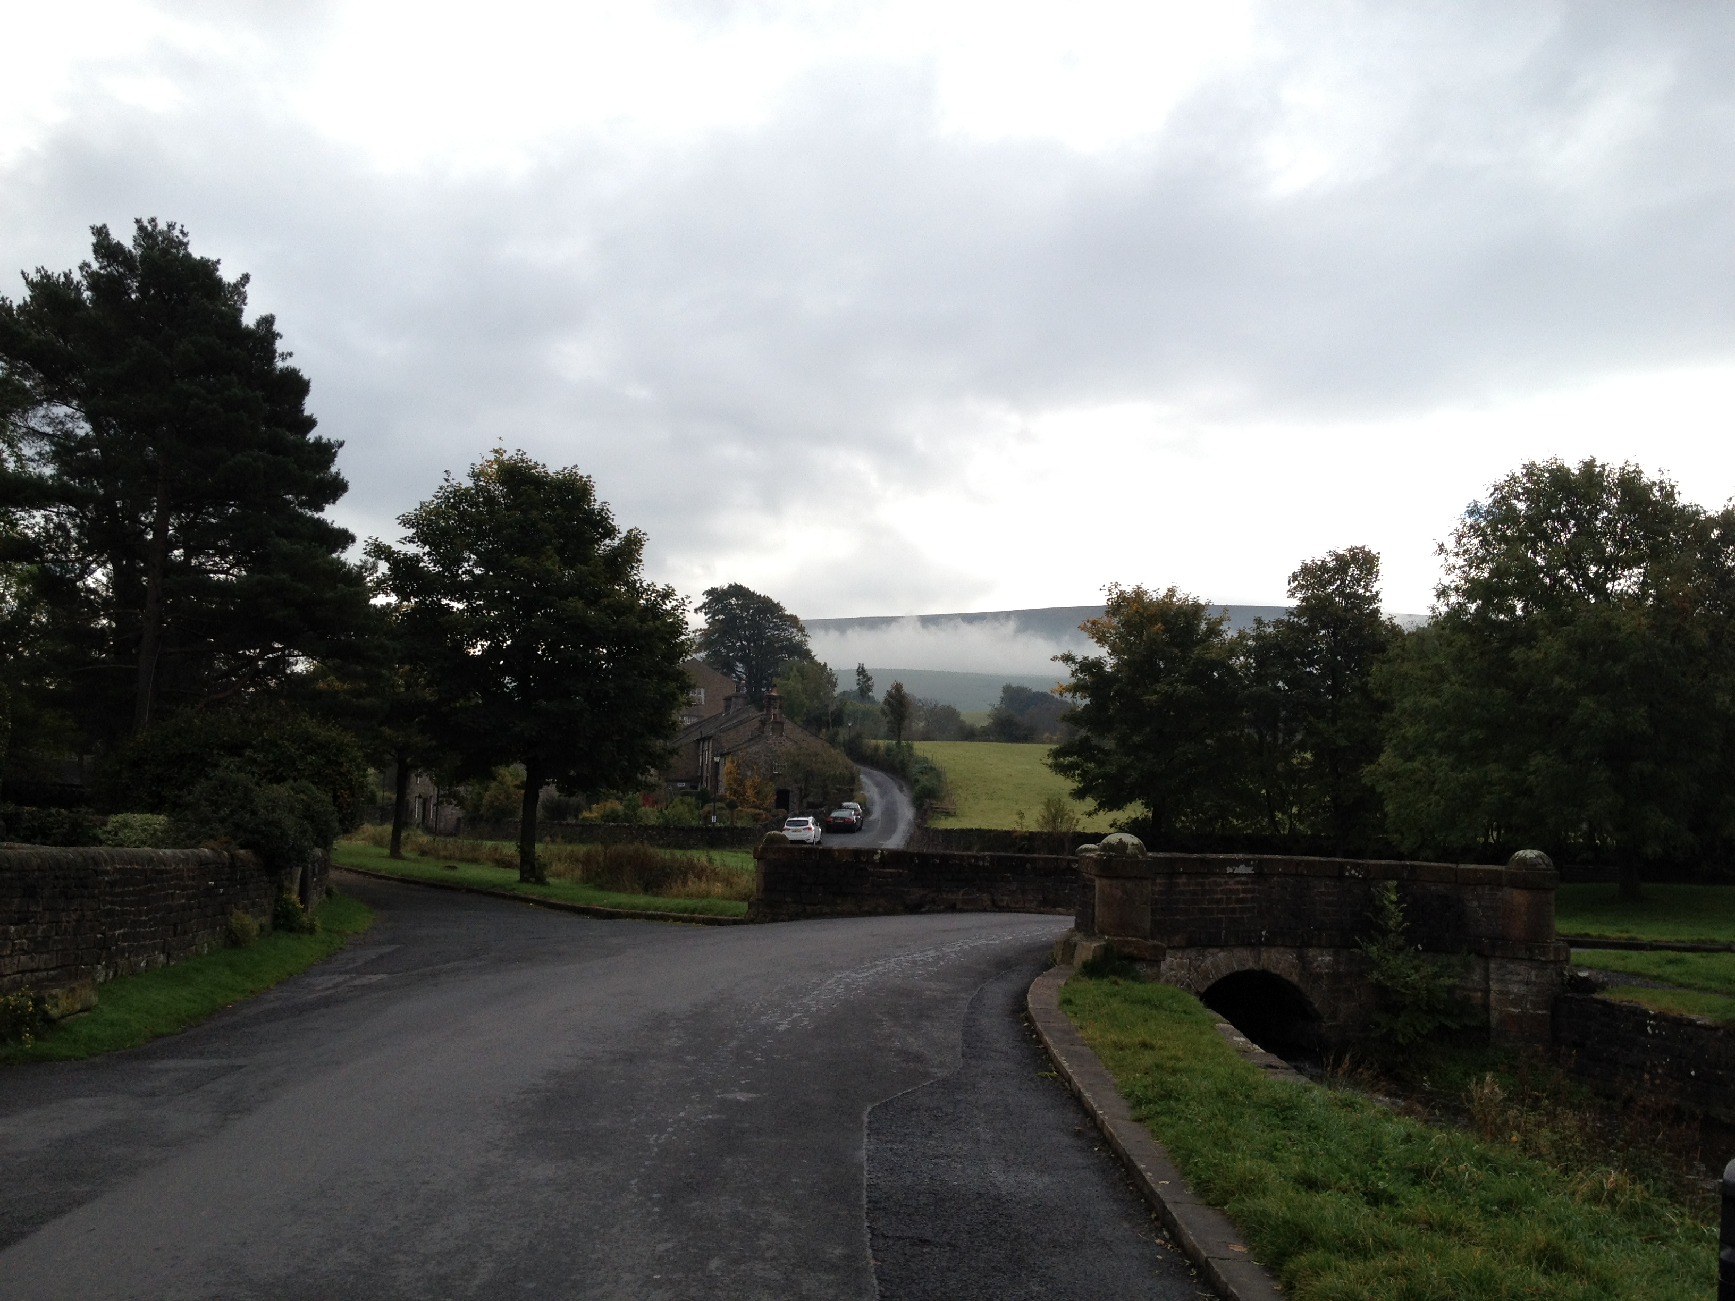

Slide 5
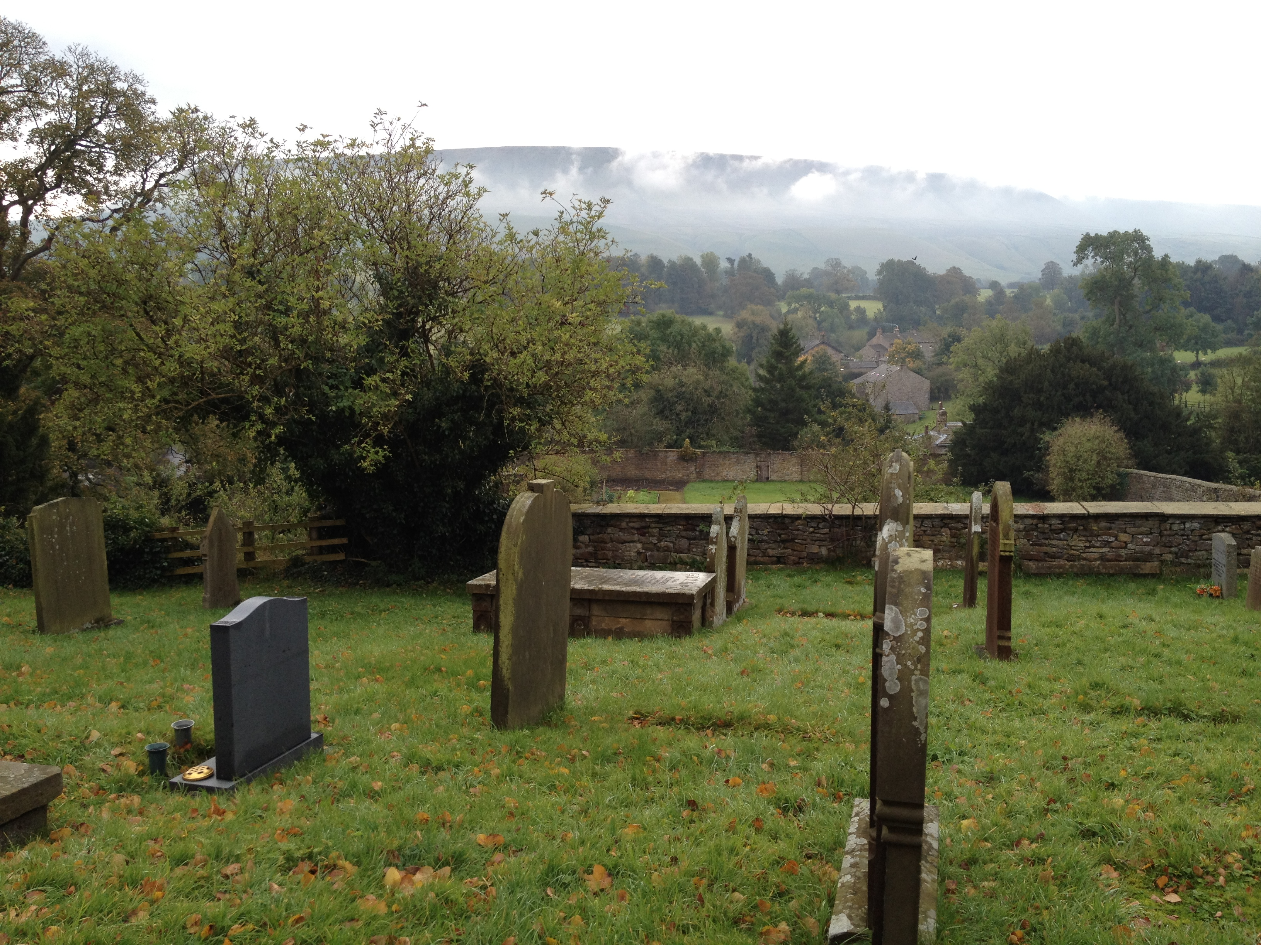

Slide 6
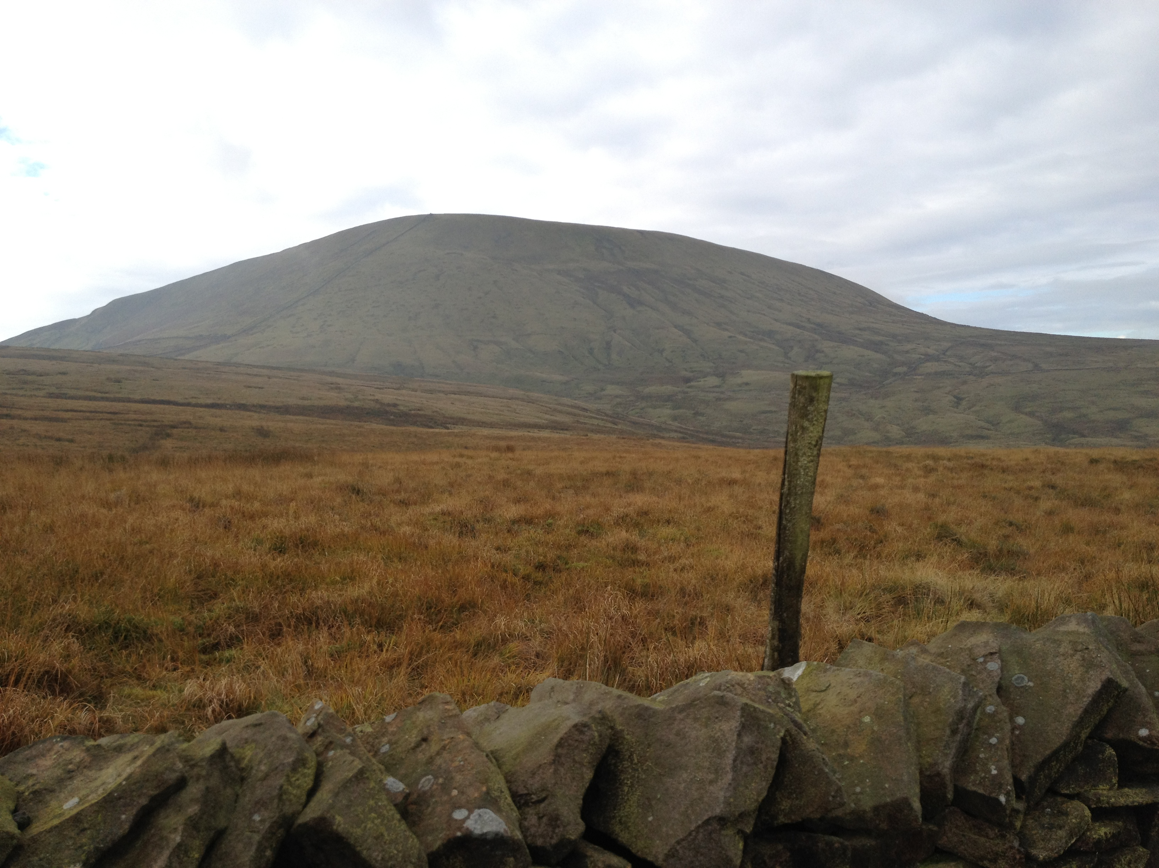

Slide 7
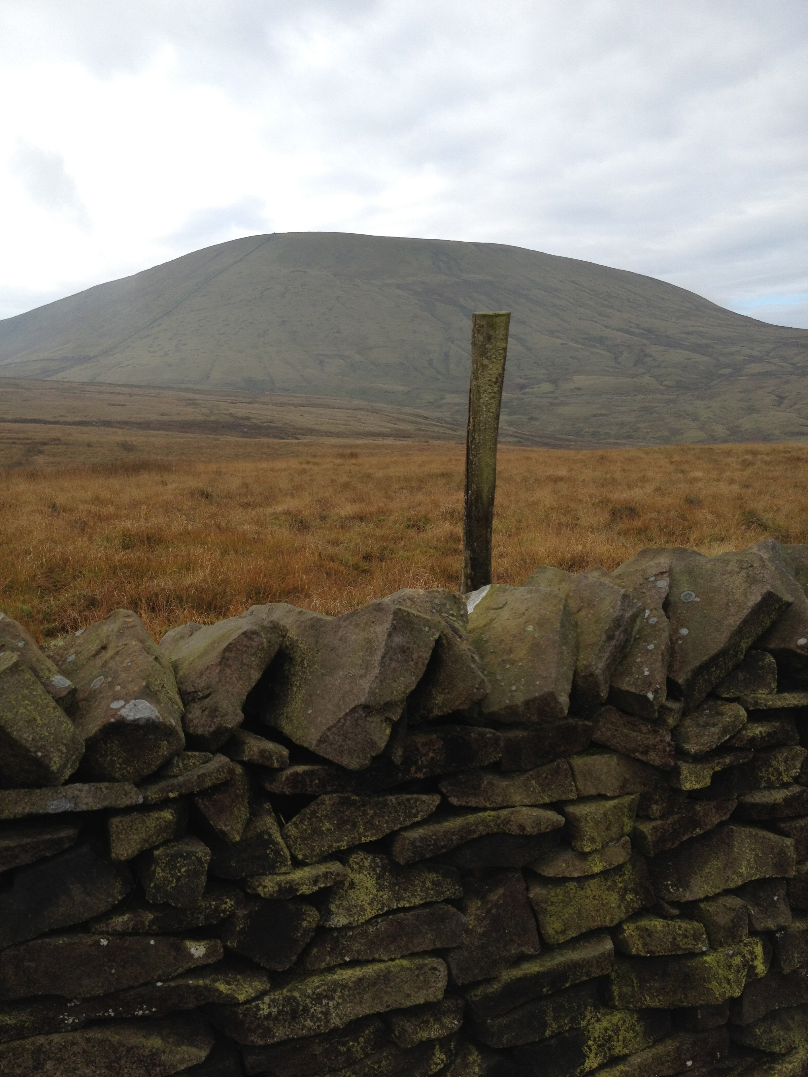

Slide 8
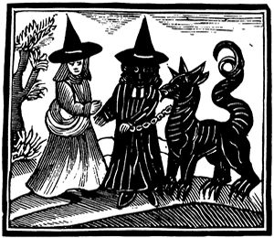
The Pendle Witches

Slide 9
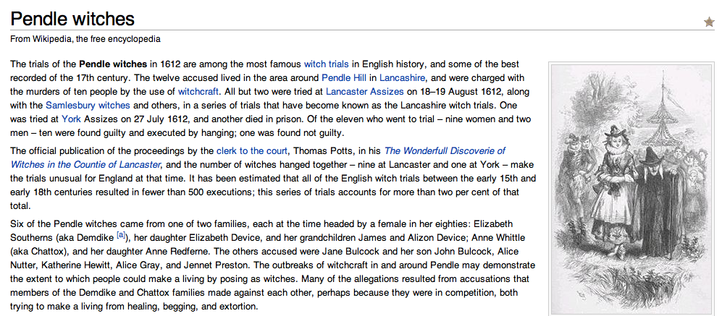

Slide 10
Alison Device sayth, that about two years ago, her grandmother did sundry times in going or walking together as they went begging persuade and advise her to let a devil or a familiar appear to her; and that she would let him suck at some part of her; and she might have and do what she would. And so not long after these persuasions, there appeared unto her a thing like unto a black dog: speaking unto her and desiring her to give him her soul, and he would give her power to do any thing she would: whereupon she being therewithal enticed, and setting her down; the said black dog did with his mouth (as she then thought) suck at her breast, a little below her paps, which place did remain blue half a year next after: which said black-dog did not appear to her, until the eighteenth day of march last
The Confession of Alison Device …
Date it:
Lexis
Syntax
Orthography
1612

Slide 12
Orthography Fun

Slide 13
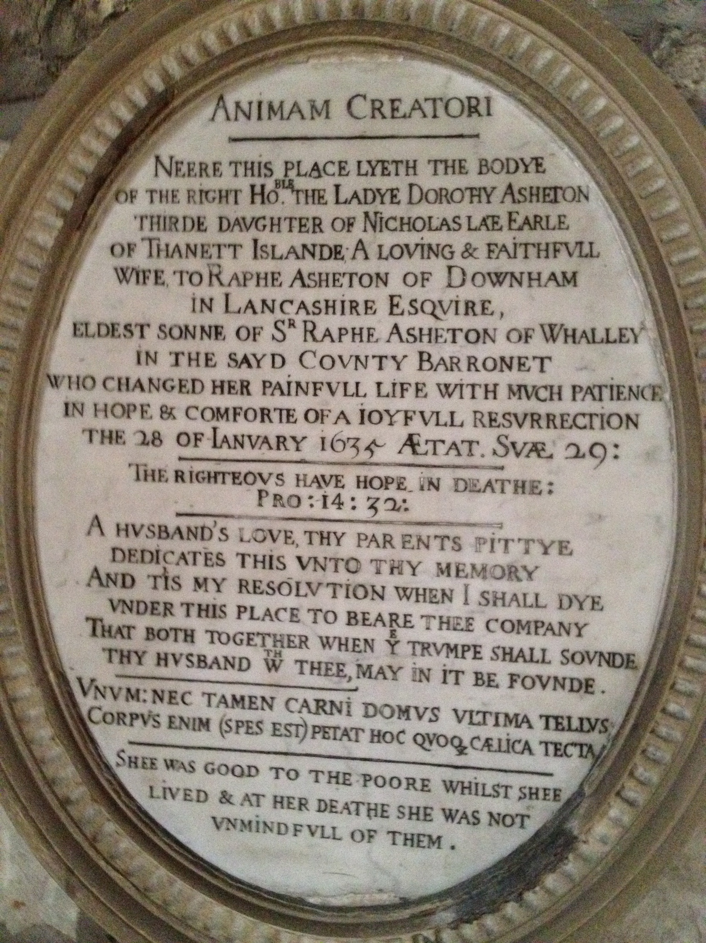

Slide 14
A generation after Caxton, the writing system of English remained inconsistent. The conventions adopted by the Chancery scribes started to be adopted (London had huge numbers of scribes; Caxton set up press in Westminster; local London speech adopted as the norm).
David Crystal, Encyclopedia of the English Language

Slide 15
Caxton in a single passage uses booke and boke, axed and axyd, and uses –e to end words in a haphazard fashion (hadde, wel, which). Similar randomness in his immediate successors: fellow spelt as fellow, felowe, fallow, fallowe.

Slide 16
Much complaint about chaotic spelling in books. Reasons: many printers were foreigners who introduced native conventions at will and were uncertain of English orthographic traditions.
Proof-reading was not always carried out by educated people. Because there was a limited amount of type, arbitrary spellings were also introduced. Printers would arbitrarily add or remove a final –e to make a line of words end neatly on the right margin.

Slide 17
1630s saw standardization of /u/ and /v/ which in medieval English had been interchangeable. Next /v/ was used initially and /u/ internally. Later, after continental practice, /v/ represented a consonant and /u/ a vowel. Similar standardization took place of /i/ and /j/.

Slide 18
By the middle of the 17thC an increasing number of spelling guides were published. Chidren’s schoolbooks contained homophones (maid/made); and the first dictionaries were being published. Spelling was becoming standardized and a gulf established between written and spoken forms. “The modern system, in which irregular spellings can be explained but not predicted, had arrived.” The period of social tolerance of variant spellings came to an end; and as 18thC notions of correctness emerged, poor spelling was increasingly stigmatized.

Slide 19
Capitals:
Benjamin Franklin in 1789 laments the passing of the age of noun capitalization, which had been a way of imitating German. Eighteenth century grammarians argued that capitals were not necessary for most nouns and the practice changed.

Slide 20
Punctuation:
Caxton inherited the convention of classical models where punctuation was used to show when to breathe, how long to pause, how to introduce emphasis and rhythmical balance into their speech. All still pretty haphazard. Chief symbols were virgule (/), period (.) found at various heights and the colon (:). There was no correspondence with modern usage

Slide 21
By the end of early modern period (1800) punctuation has largely been established.

Slide 22
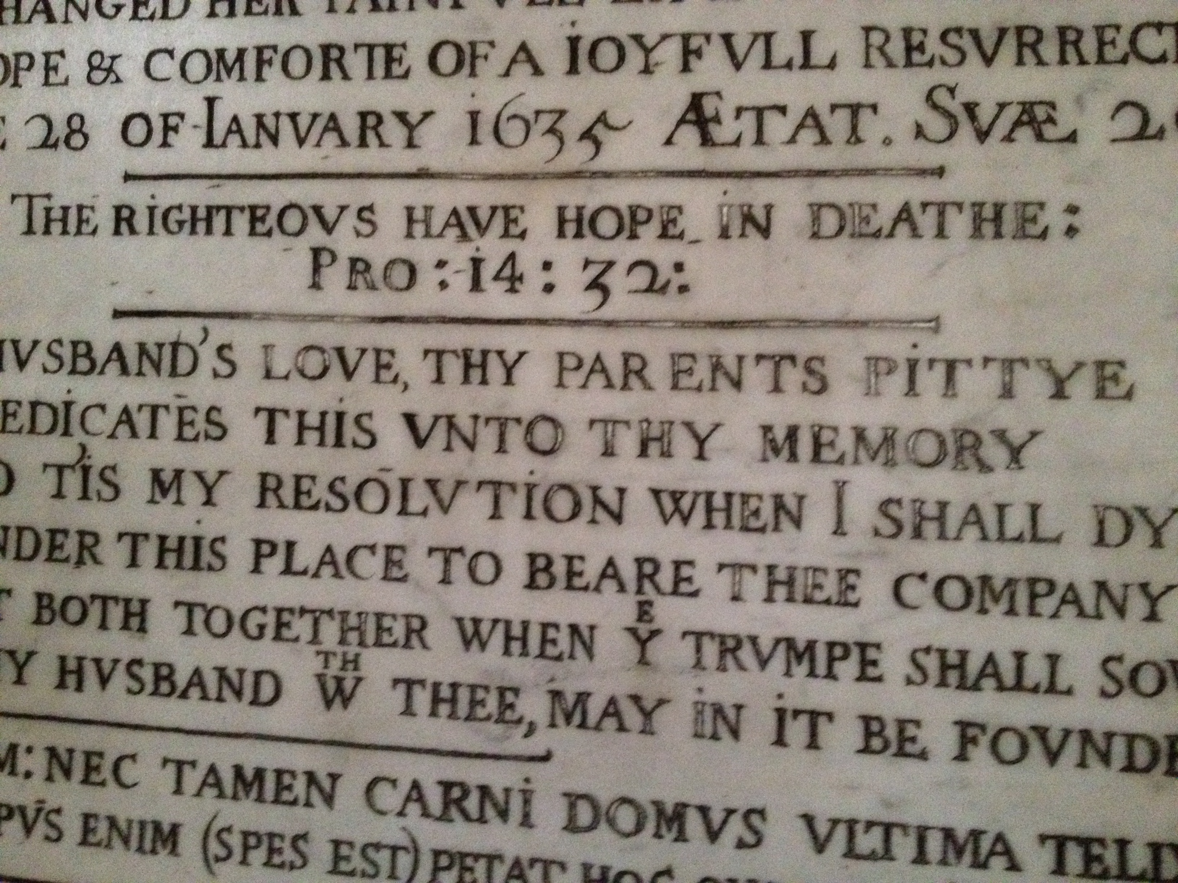

Slide 23
Next week Mr B asks:
“Where in the world?”
… and we head overseas

Slide 24
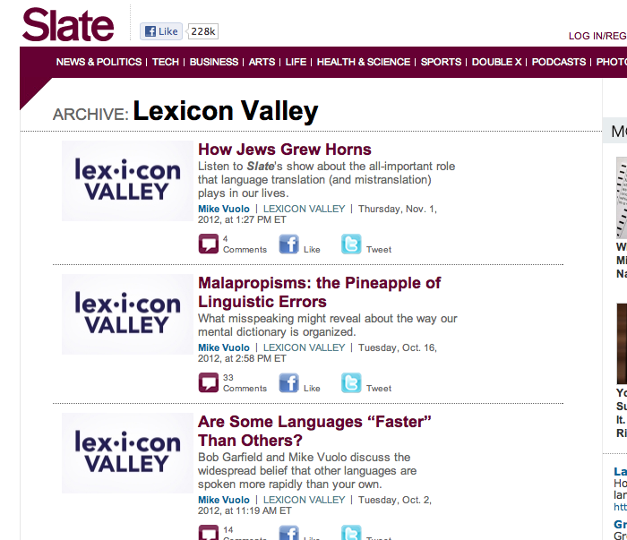

Slide 25
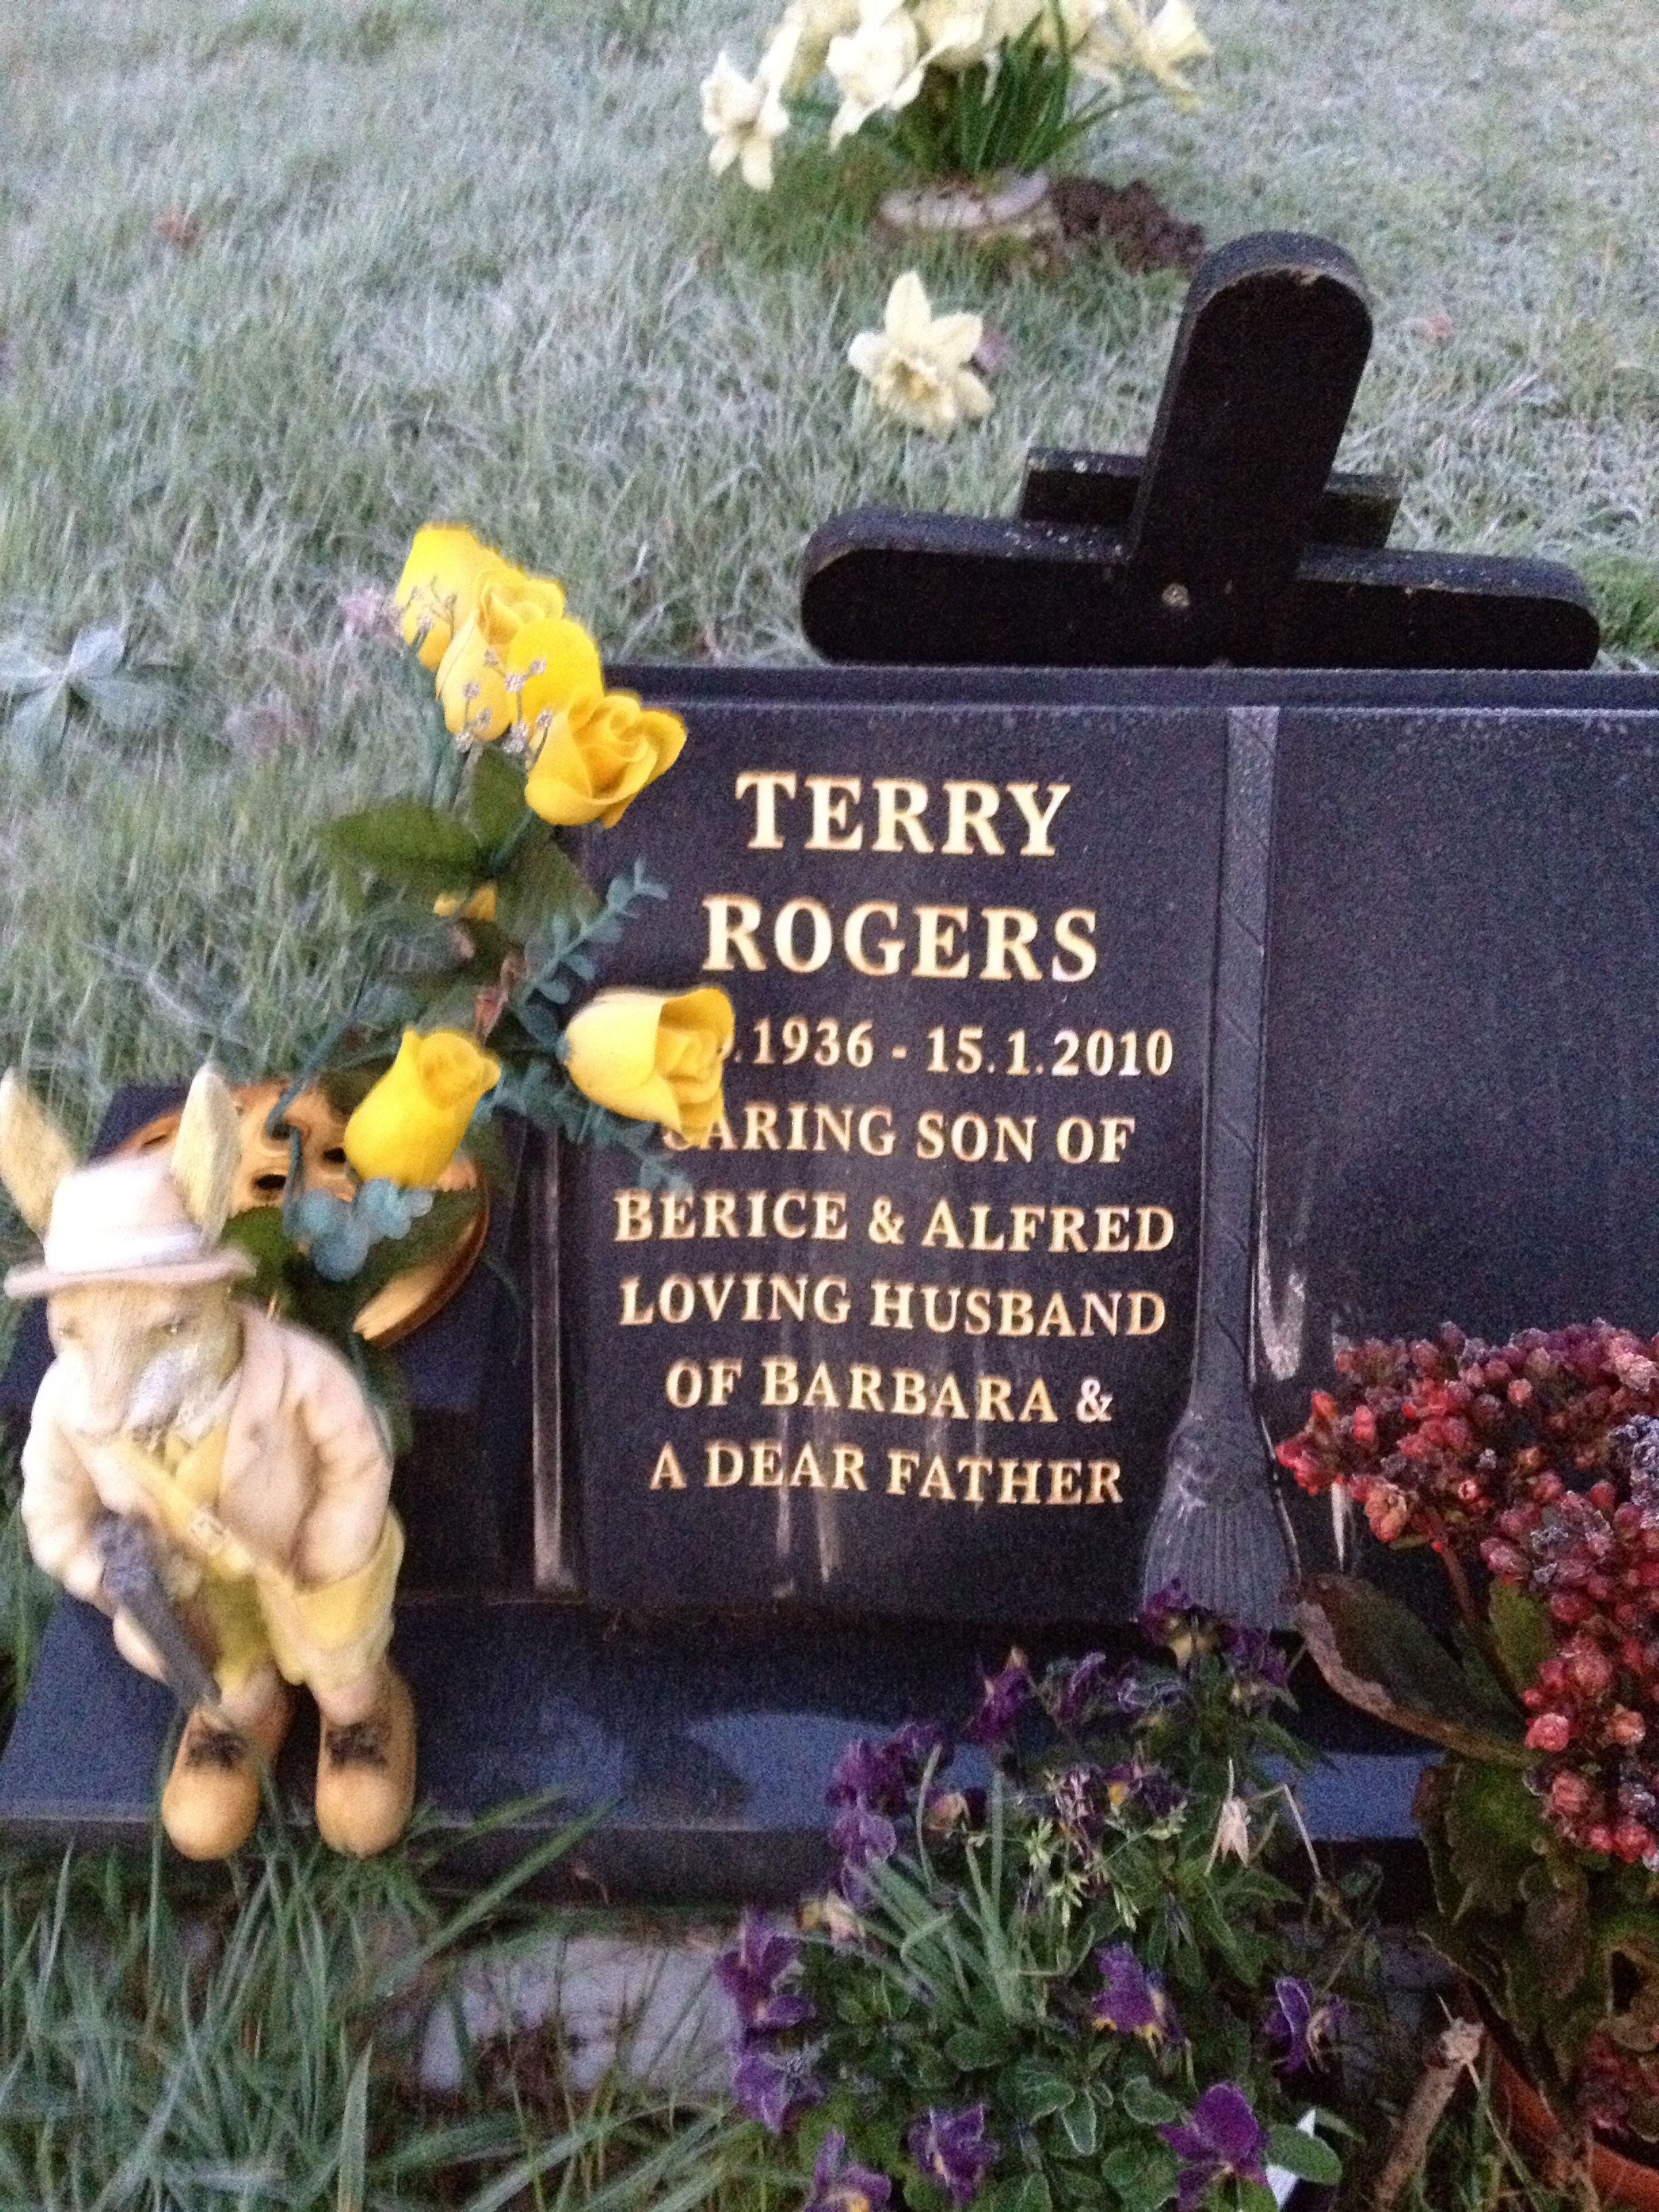

Slide 26
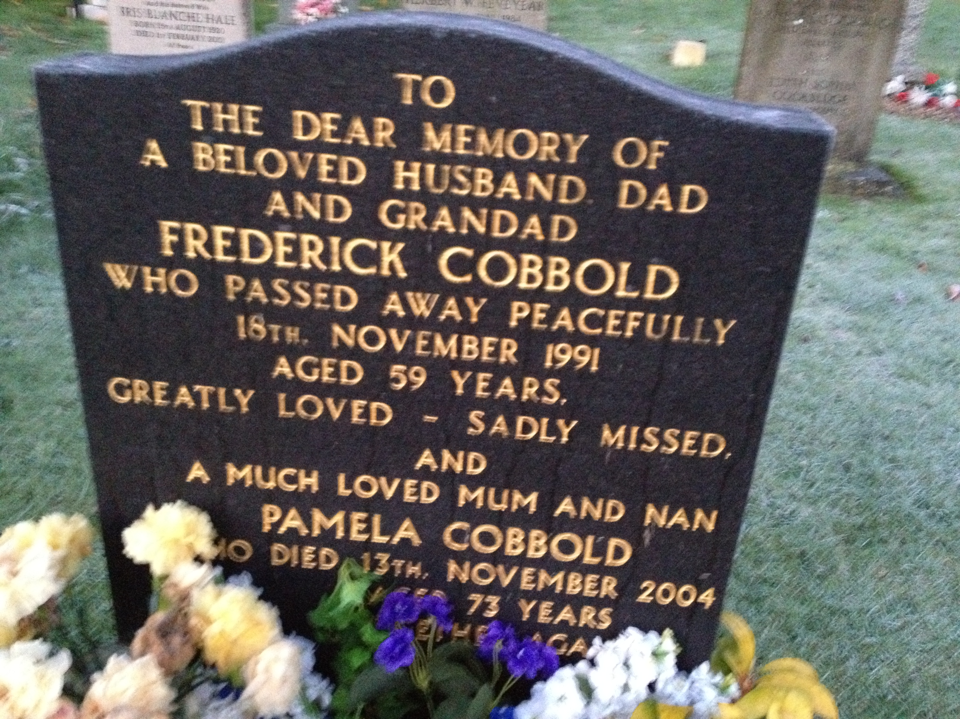

Slide 27
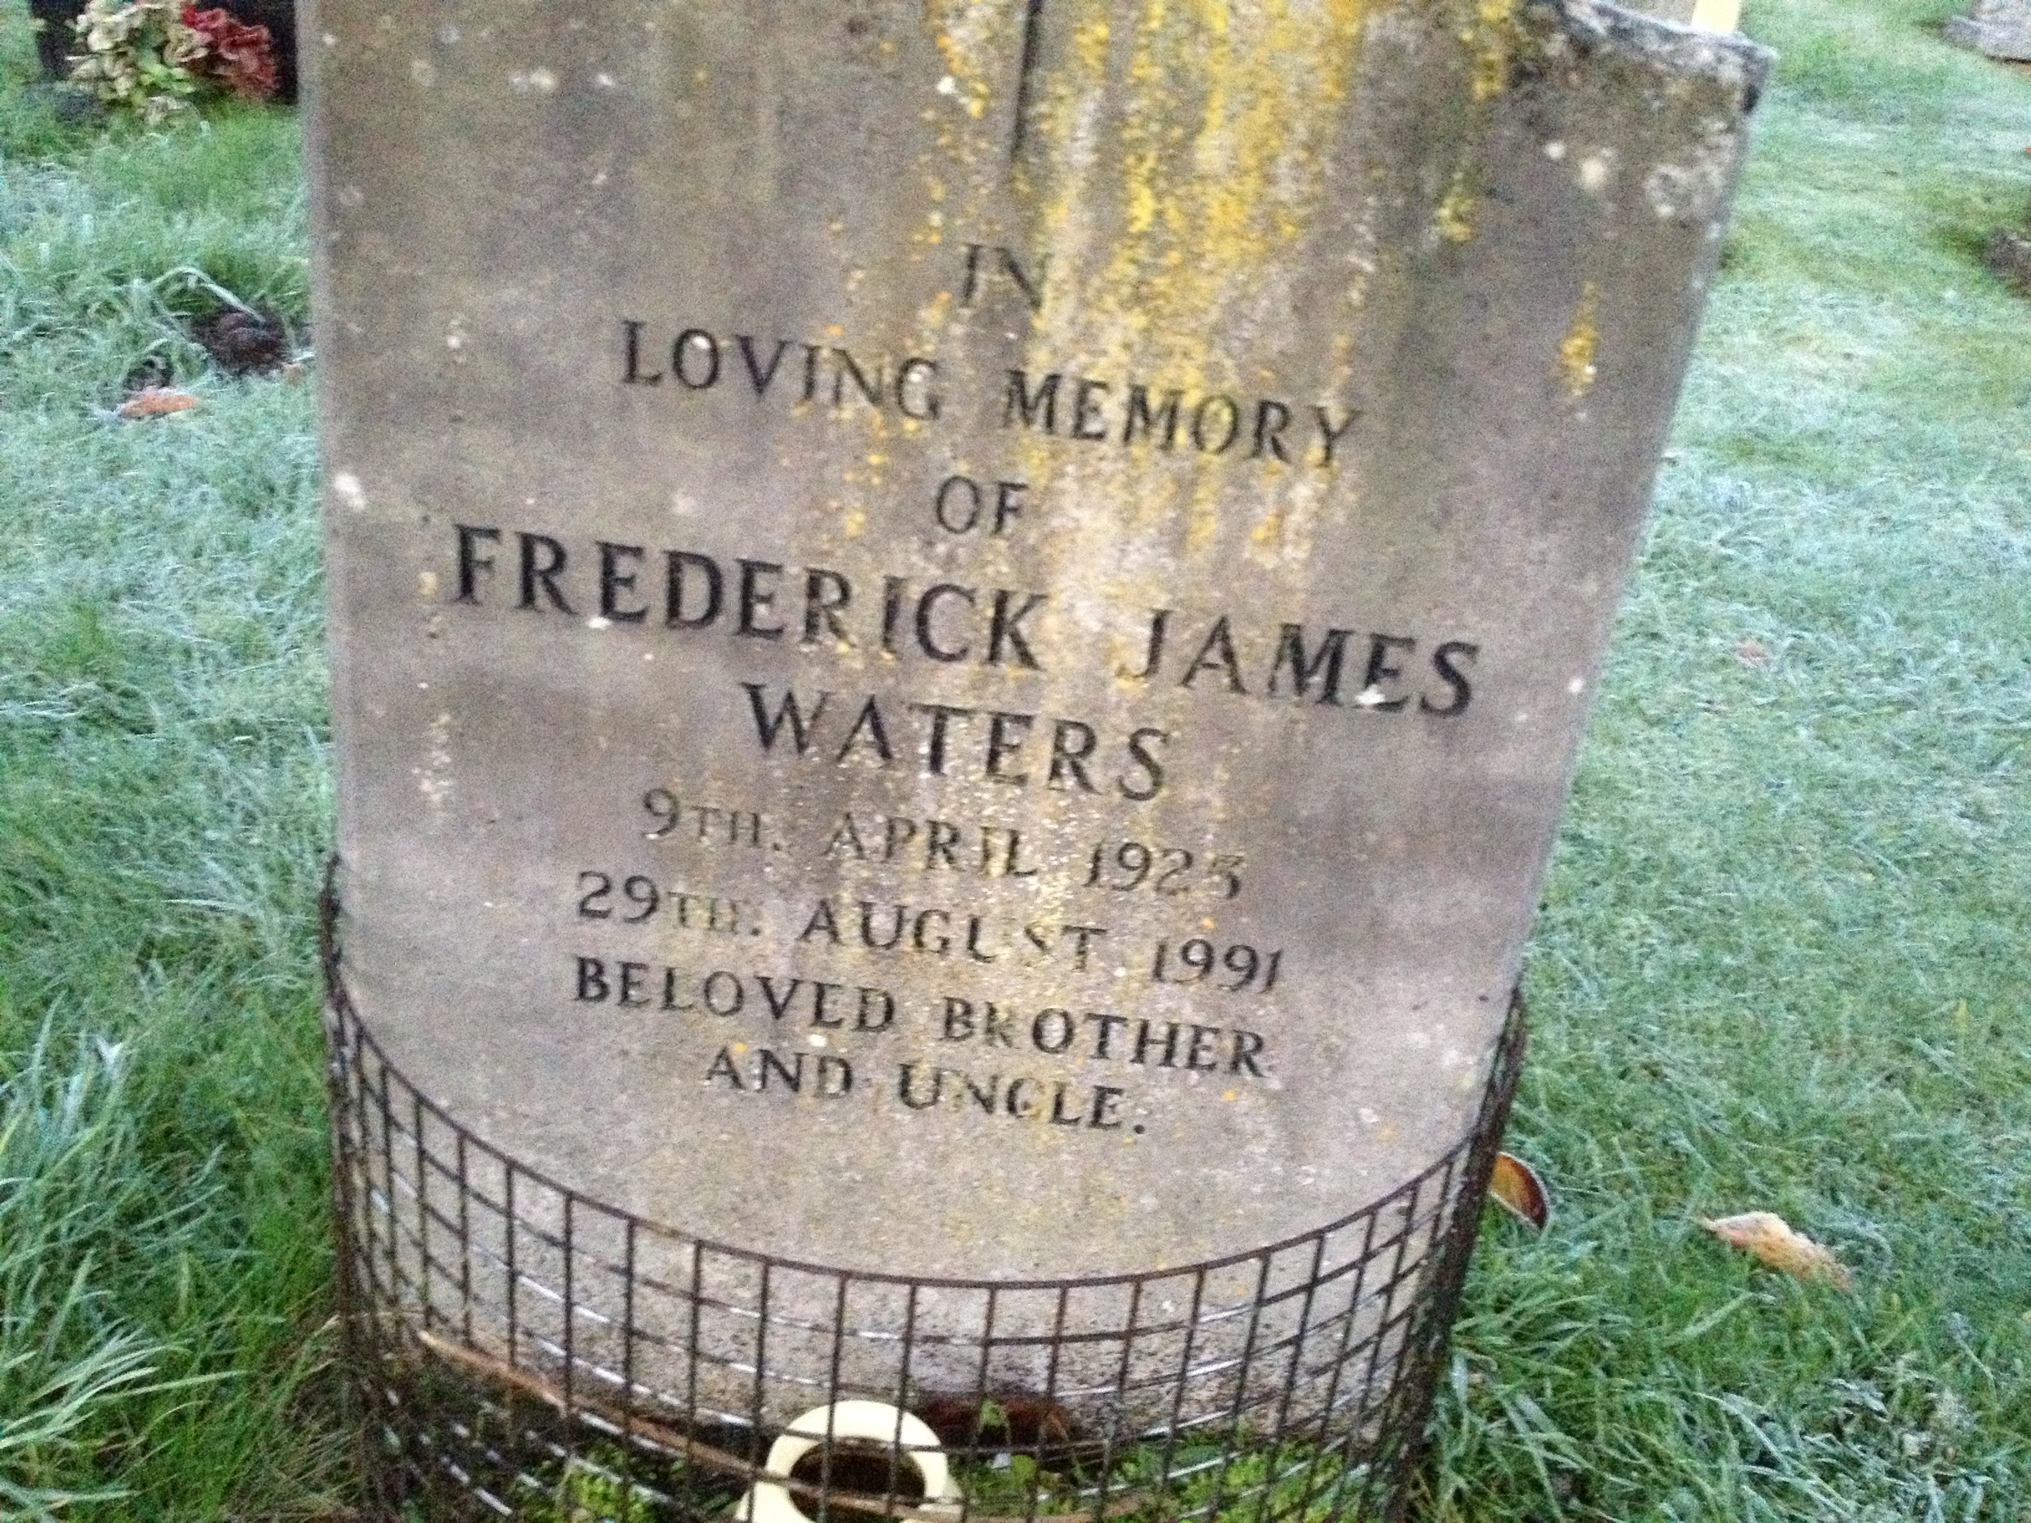

Slide 28
